Slide 1

Oracle 11g: SQL
Chapter 2
Basic SQL SELECT Statements

Slide 2
Objectives
Identify keywords, mandatory clauses, and optional clauses in a SELECT statement
Select and view all columns of a table
Select and view specific columns of a table
Use a column alias to re-title the contents of a particular column in a query
Perform basic arithmetic operations in the SELECT clause
Remove duplicate lists using either the DISTINCT or UNIQUE keyword
Use concatenation to combine fields, literals, etc.
Oracle 11g: SQL

Slide 3
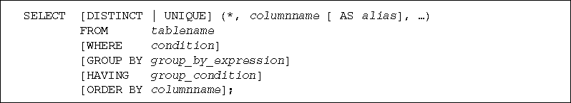
SELECT Statement Syntax
SELECT statements are used to retrieve / retrieve data from the database
  Referred to as a query
Oracle 11g: SQL

Slide 4
SELECT Statement Syntax (continued)
SELECT and FROM clauses are required
SELECT clause identifies column(s)
FROM clause identifies table(s)
Oracle 11g: SQL
Notes:
All other clauses (e.g. WHERE) are optional
SELECT clause does a projection (vertical slice)
WHERE clause does a selection (horizontal slice)

Slide 5
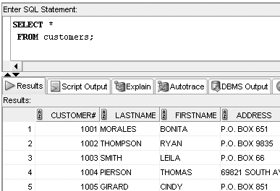
Selecting All Data in a Table
Use an asterisk for the columns in SELECT clause
Oracle 11g: SQL

Slide 6
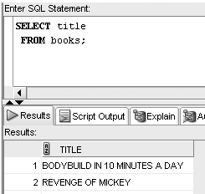
Selecting One Column from a Table
Enter column name in SELECT clause
Oracle 11g: SQL

Slide 7
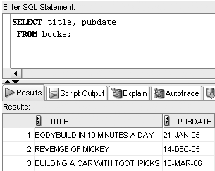
Selecting Specific Columns from a Table
Separate column names with a comma
Oracle 11g: SQL

Slide 8
Operations within the SELECT Statement
Column alias can be used for column headings
Arithmetic operations to produce new values
Suppress duplicates
Concatenate text values
Oracle 11g: SQL

Slide 9
Using Column Aliases
List the alias after the column heading
AS keyword is optional
Enclose heading in double quotation marks:
  If it contains blank space(s)
  If it contains special symbol(s)
  To retain mixed case
Oracle 11g: SQL

Slide 10
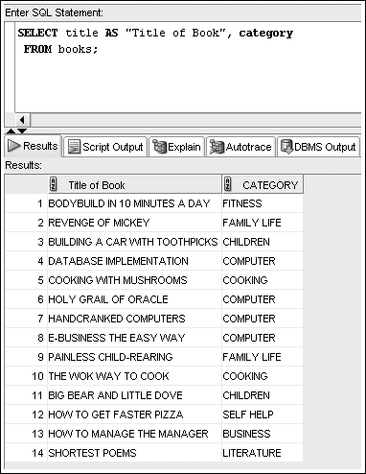
Using Column Aliases Example
Oracle 11g: SQL

Slide 11
Using Arithmetic Operations
Arithmetic operations
  Executed left to right
  Multiplication and division are solved first
  Addition and subtraction are solved last
  Override order with parentheses
Oracle 11g: SQL

Slide 12
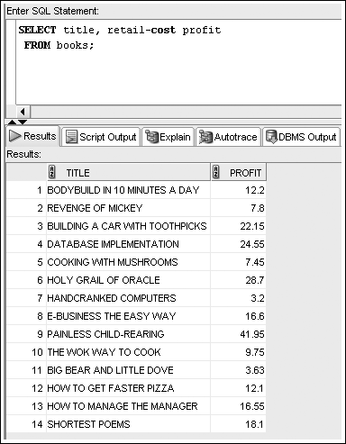
Example Arithmetic Operation with Column Alias
Oracle 11g: SQL

Slide 13
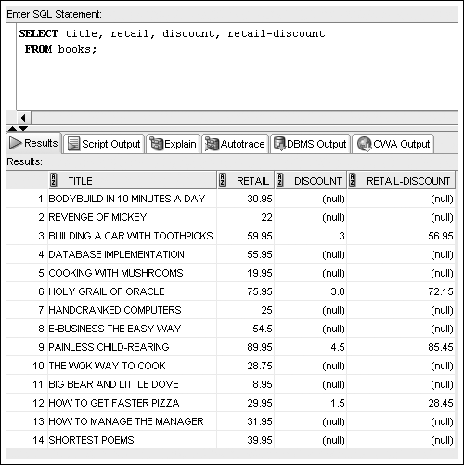
NULL Values in Arithmetic
NULL in any operation produces a NULL result
Oracle 11g: SQL

Slide 14
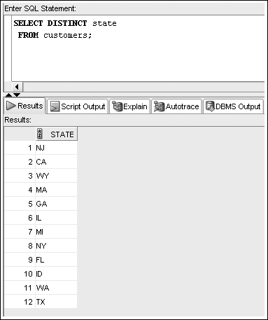
Using DISTINCT and UNIQUE
Enter DISTINCT or UNIQUE after SELECT keyword to suppress duplicates

Slide 15
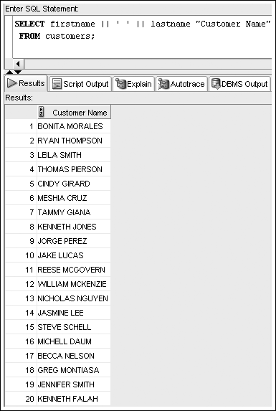
Using Concatenation
You can combine text data with string literals
Use the concatenation operator ||
Allows the use of column aliases
Oracle 11g: SQL

